Slide 1
DOCTOR APPOINTMENT SYSTEM USING DJANGO ANGULAR AND PYTHON
Web Development for Information Systems
Student ID | Student Name
10612366 | Navin Kumar Singupuram

Slide 2
Agenda
Introduction
Technology Stack
UX Design
Proof of Concept
Highlights of Code
Conclusion
Features of Application
B9IS109 Web Development for Information Systems, Dublin Business School

Slide 3
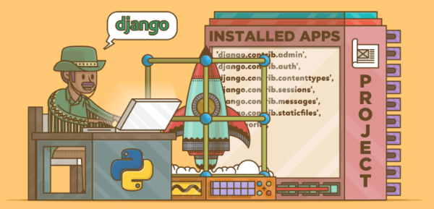
INTRODUCTION
A doctor appointment booking system is an online tool that enables patients to conveniently schedule an appointment at a specific clinic for a health concern.
Can be benefitted greatly from a doctor appointment booking system on your clinic's or doctor's website.
Advantages:
Time and money savings.
Saves resources.
Makes it easy to manage all the appointments and bookings.
Proper following of the guidelines in times of health crisis.
No rush hours and better sessions with the doctor.
Better flow of income.
Income from pre-bookings.
Convenient for patients to easily book appointments.
B9IS109 Web Development for Information Systems, Dublin Business School

Slide 4
TECHNOLOGY STACK
Front End Technologies
HTML
CSS 3
Angular JS
Bootstrap 5
IDE and Database
DJANGO 4.1
Sql Lite 3 - 3.41. 2
Tools
Postman
Hosting Service
Git Hub
Deployment
AWS EC2
B9IS109 Web Development for Information Systems, Dublin Business School

Slide 5
UX DESIGN AND FLOW
Sign Up
Footer
Home Page
Social Media
Copyright
Navbar
Login
Login
About Us
Team
Services
Home
Team
Services
Book
Services
Performed
Book Appointment
Services
Specialists
About Us
Book Now
Search Specialist
B9IS109 Web Development for Information Systems, Dublin Business School

Slide 6

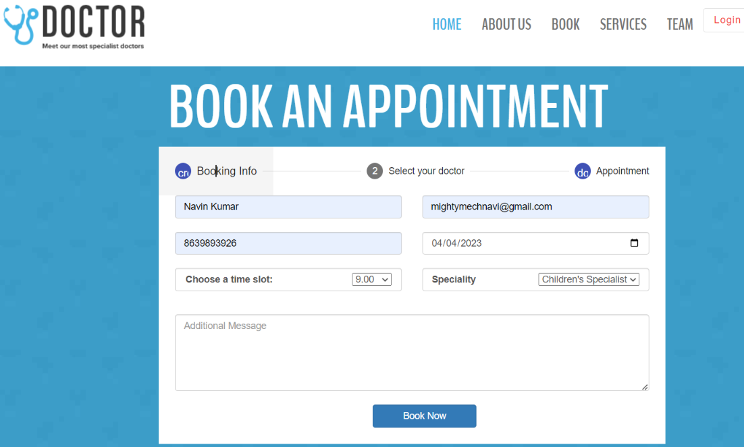
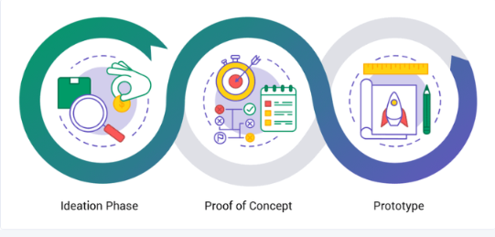
PROOF OF CONCEPT
B9IS109 Web Development for Information Systems, Dublin Business School

Slide 7
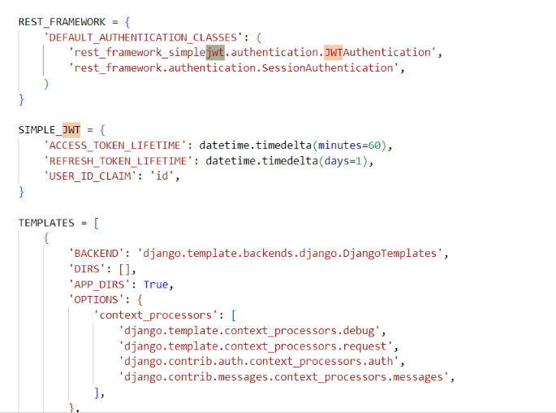
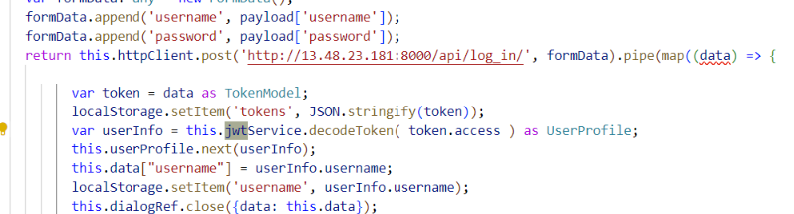
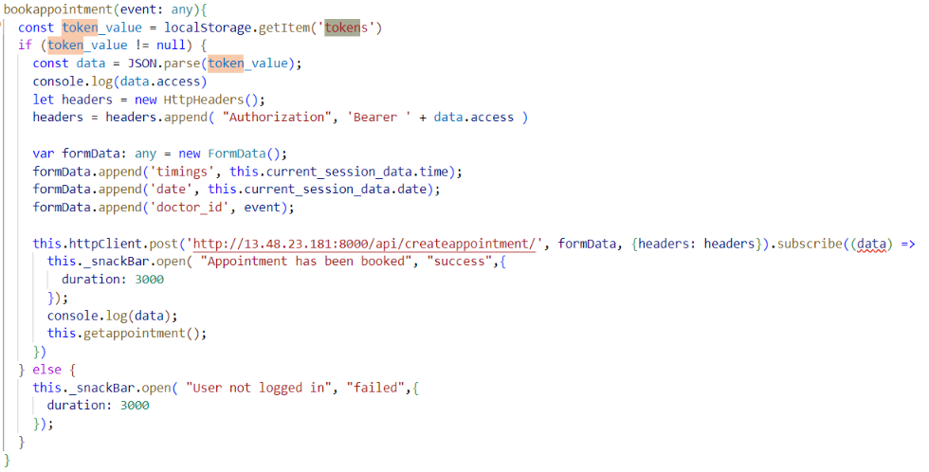
JWT Authentication
Highlights of Code
B9IS109 Web Development for Information Systems, Dublin Business School

Slide 8
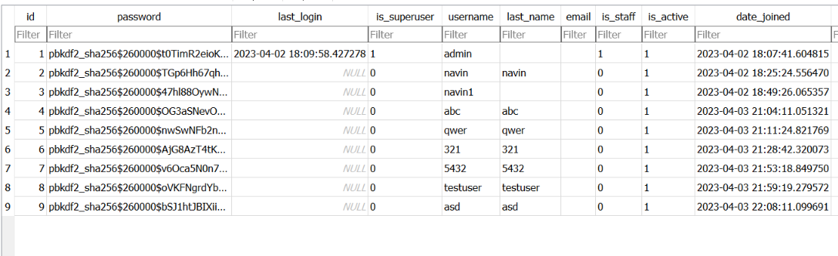
Encrypted Data
Highlights of Code
B9IS109 Web Development for Information Systems, Dublin Business School

Slide 9
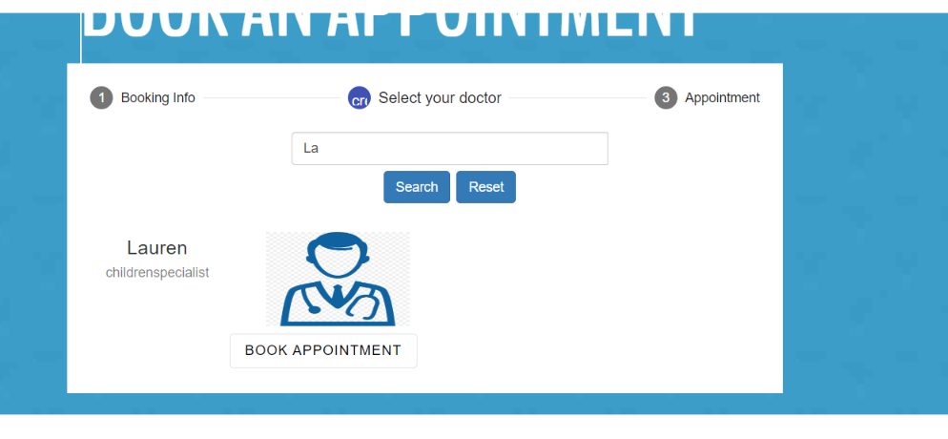
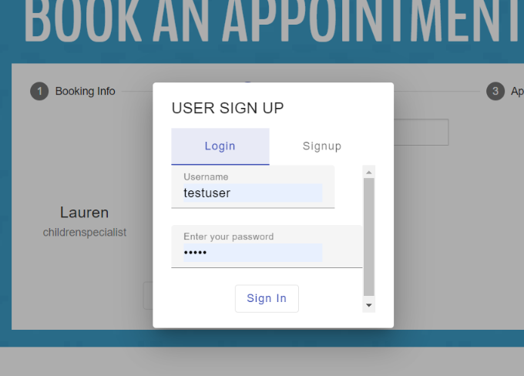
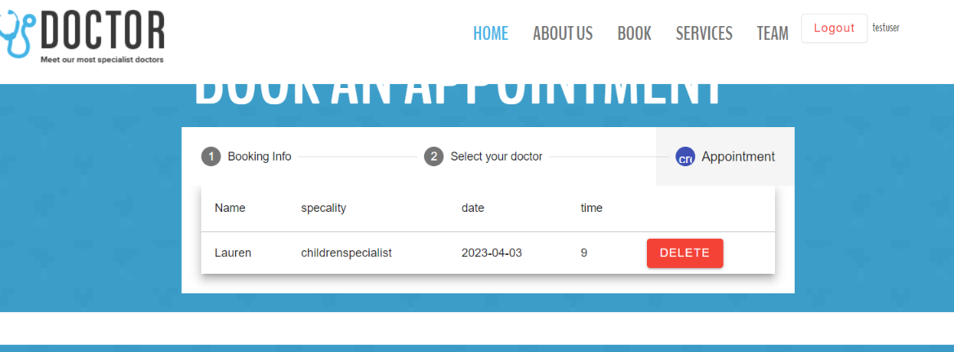
FEATURES
SEARCH FUNCTIONALITY
SIGN UP
LIST VIEW APPOINTMENT
B9IS109 Web Development for Information Systems, Dublin Business School

Slide 10

THANK YOU
B9IS109 Web Development for Information Systems, Dublin Business School

